Slide 1

Types of Search Engine Optimization

Slide 2
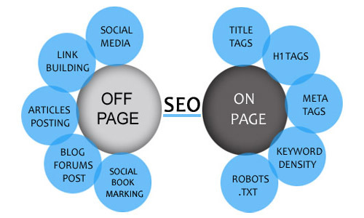
Types of SEO
One-Page Optimization
Off –Page Optimization

Slide 3
On-Page Optimization
On-page optimization (AKA on-page SEO) refers to all measures that can be taken directly within the website in order to improve its position in the search rankings.
Examples of this include measures to optimize the content or improve the meta description and title tags.

Slide 4
Elements of On-Page Optimization
There are three main technical components of a website that can be optimized:
Technical Optimization
Server Speed
Source Code
IP-addresses
Content
Text
Structural text elements
Graphics
Videos
Meta-Tags
https://www.searchmetrics.com

Slide 5
Elements of On-Page Optimization
There are three main technical components of a website that can be optimized:
Internal links and structure
Logical structure and crawl depth
Internal Linking
Canonization
URL Structure
Design
Mobile optimization
File sizes
Call to Action
https://www.searchmetrics.com

Slide 6
Keyword Placement Places
Meta Tag
Heading (H1-H6)
Text
Domain Name
URL optimizer
Alt Text

Slide 7
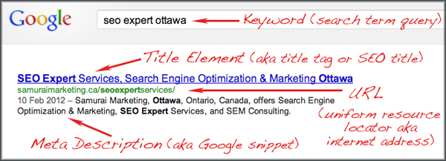
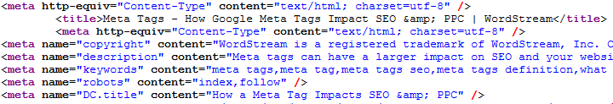
Meta Tag
Meta tags are a type of HTML tag that provides search engines with information about a website page.
Meta-Tags are the words hidden in your website code
Legal way of hiding words in webpages
https://www.wordstream.com/meta-tags

Slide 8
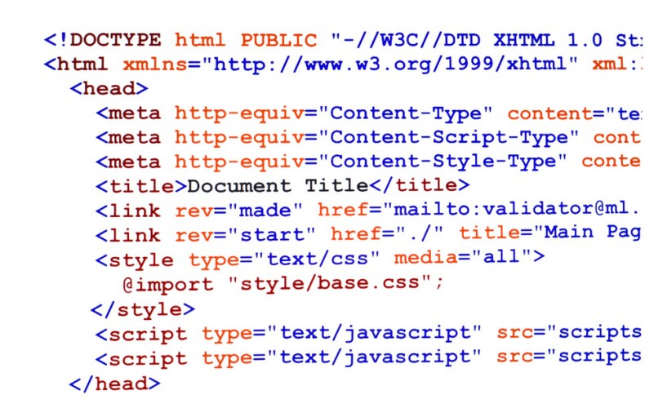
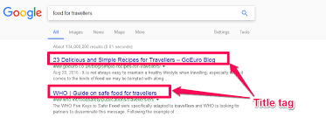
Title Tags
Title tags are used by search engine to identify the subject of the page.
<title>types of digital marketing</title>

Slide 9
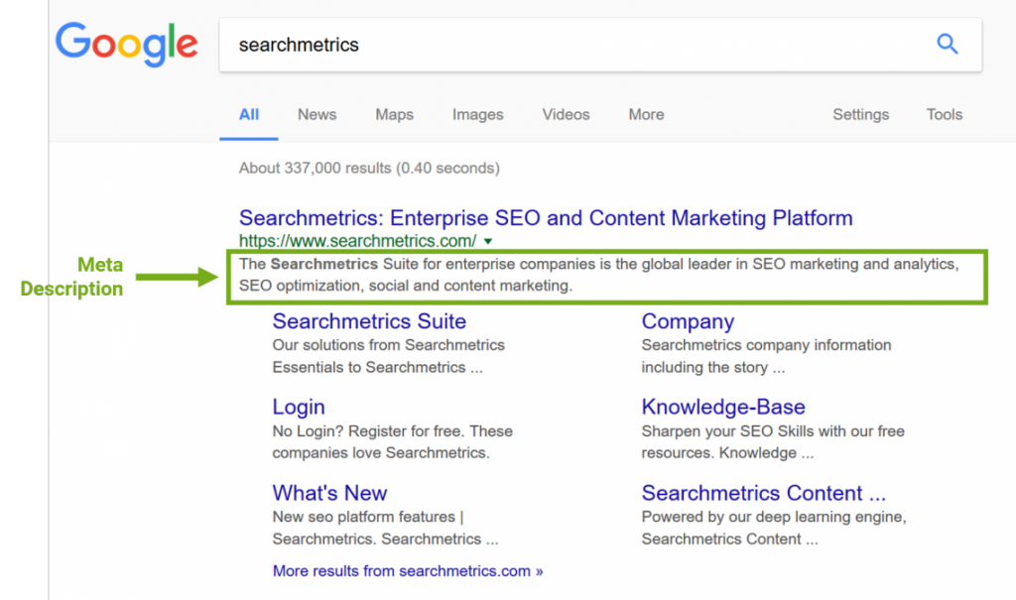
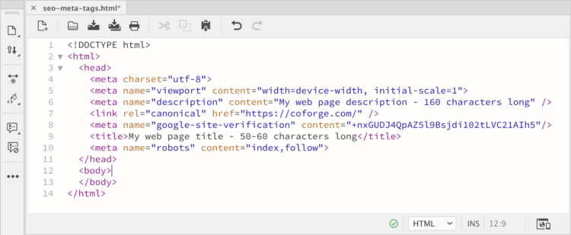
Description Tag
Meta Description tag is a short paragraph of the website written in HTML

Slide 10
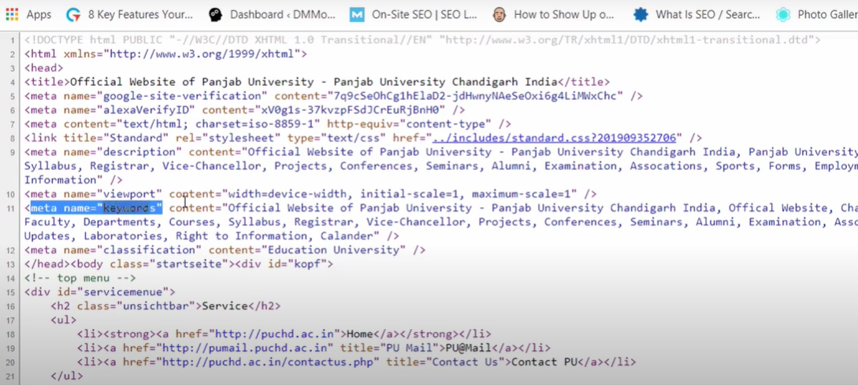
Keyword Meta tag
Keyword tag is usually used to include 8-9 important keywords describing the webpage

Slide 11
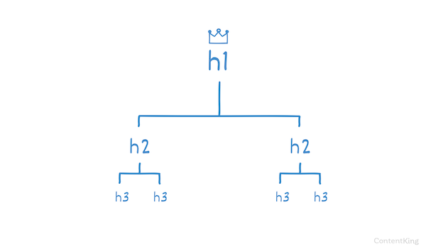
Heading Tag
The <h1> to <h6> tags are used to define HTML headings.
<h1> defines the most important heading. <h6> defines the least important heading.
Note: Only use one <h1> per page - this should represent the main heading/subject for the whole page. Also, do not skip heading levels - start with <h1>, then use <h2>, and so on.
Global Attributes
The <h1> to <h6> tags also supports the Global Attributes in HTML.
Event Attributes
The <h1> to <h6> tags also supports the Event Attributes in HTML.
Headings are used to provide hierarchy and clarity to a web page. This helps visitors quickly scan the page and helps search engines understand its structure and topic.
Free tool:- H1 and all Header Tag Checker Tool (seoptimer.com)
https://www.seoreviewtools.com/html-headings-checker/

Slide 12
Keyword Density
Keyword density refers to the number of times a keyword appears on a given webpage or within a piece of content as a ratio or percentage of the overall word count. This is also sometimes referred to as keyword frequency, or the frequency with which a specific keyword appears on a webpage.
Keyword density formula
Keyword density can also be calculated as a specific figure, should you need to. To determine the keyword density of a webpage, simply divide the number of times a given keyword is mentioned by the total number of words on the page – the resulting figure is the keyword density of that page.
https://www.wordstream.com/keyword-density
https://smallseotools.com/keyword-density-checker/

Slide 13
Keyword Domain
A keyword domain is a domain name with keywords in it (example, BuyWidgets.com).
Search with the keyword and fine the result: How to set up a website
A branded domain is a domain name without the keywords in it (example, Amazon.com). ...
The search engines helped the keyword domain industry by ranking those parked domain names in the search results.

Slide 14
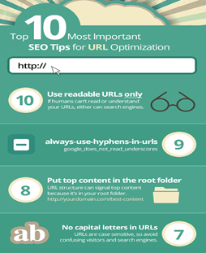
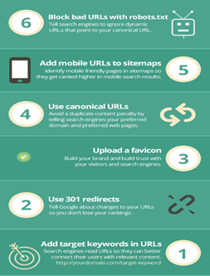
URL Optimizer
URL is just a unique finger print that holds the unique location of a web page on the internet.

Slide 15
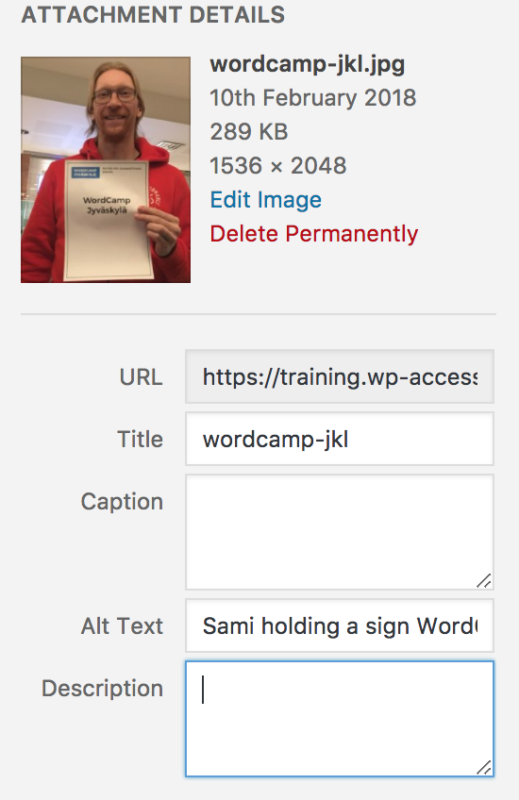
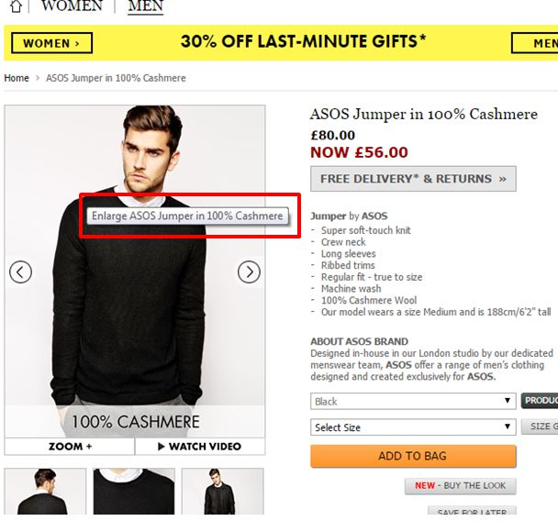
AltText
Also called "alt tags" and "alt descriptions," alt text is the written copy that appears in place of an image on a webpage if the image fails to load on a user's screen.
This text helps screen-reading tools describe images to visually impaired readers and allows search engines to better crawl and rank your website

Slide 16
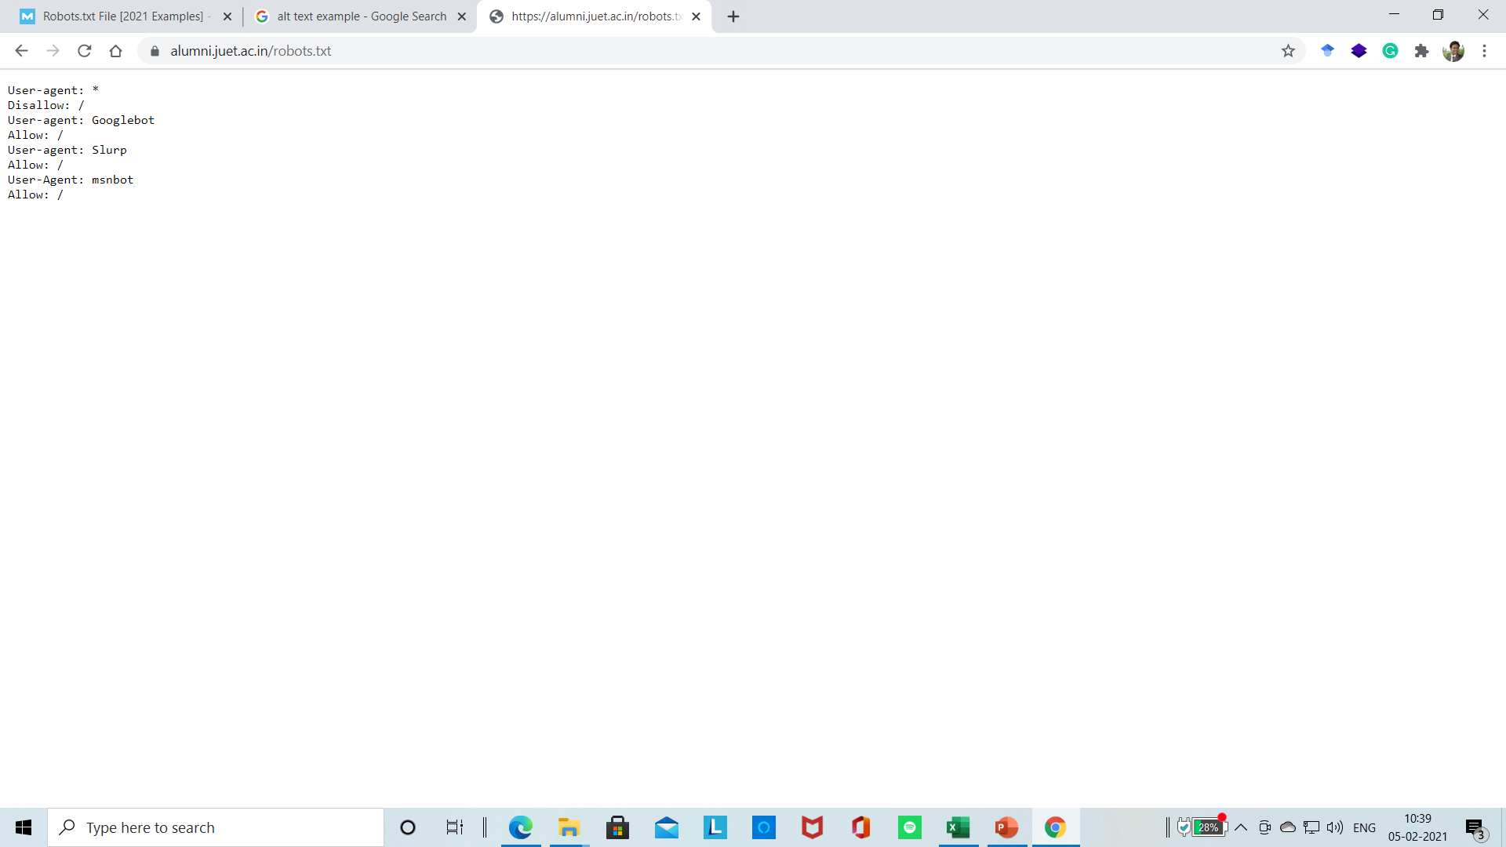
Robot.txt
Robots. txt is a text file webmasters create to instruct web robots (typically search engine robots) how to crawl pages on their website.
Basic format:
User-agent: [user-agent name]Disallow: [URL string not to be crawled]

